Slide 1
Trees
Reading: Chapter 8
Data Structures and Algorithms in Java, 6th edition, by M. T. Goodrich, R. Tamassia, and M. H. Goldwasser, Wiley, 2014
Make Money Fast!
Stock
Fraud
Ponzi
Scheme
Bank
Robbery

Slide 2

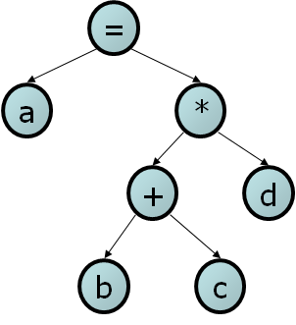
General Trees
Trees: most important nonlinear data structures in computing
Relationships in a tree are hierarchical, with some objects being “above” and some “below” others
“parent,” “child,” “sibling”, “ancestor,” and “descendant” being the most common used used to describe relationships.
folders/files on a computer
Family tree
compilers: parse tree

Slide 3
What is a Tree in Computer Science
A tree is an abstract data type that stores elements hierarchically
A tree consists of nodes with a parent-child relation
Applications:
  Organization charts
  File systems
  Programming environments

Slide 4
Tree Terminology
Root: node without parent (A)
Internal node: node with at least one child (A, B, C, F)
External node (a.k.a. leaf ): node without children (E, I, J, K, G, H, D)
Ancestors of a node: parent, grandparent, grand-grandparent, etc.
Depth of a node: number of ancestors
Height of a tree: maximum depth of any node (3)
Descendant of a node: child, grandchild, grand-grandchild, etc
Degree of a node: number of children
Subtree: tree consisting of a node and its descendants
A
B
C
D
E
F
G
H
More explanations in next slides
subtree
I
J
K

Slide 5
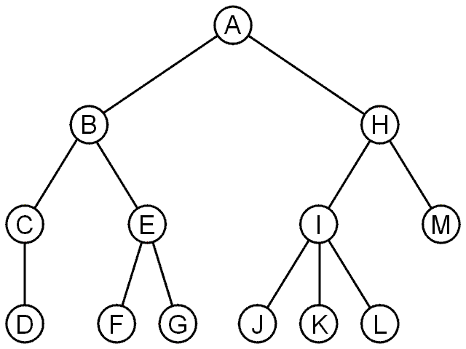
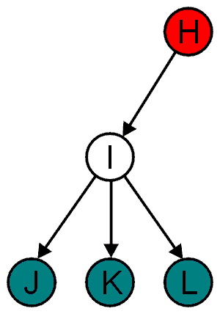
Tree Terminology
A rooted tree data structure stores information in nodes
  Similar to linked lists:
    There is a first node, or root
    Each node has variable number of references to successors
    Each node, other than the root, has exactly one node pointing to it
All nodes will have zero or more child nodes or children
  I has three children: J, K and L
For all nodes other than the root node, there is one parent node
  H is the parent I

Slide 6
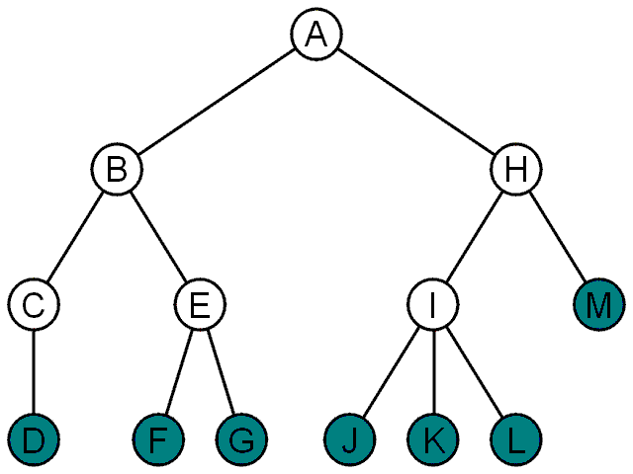
Tree Terminology
The degree of a node is defined as the number of its children: deg(I) = 3
Nodes with the same parent are siblings
  J, K, and L are siblings
Nodes with degree zero are also called leaf nodes
All other nodes are said to be internal nodes, that is, they are internal to the tree

Slide 7
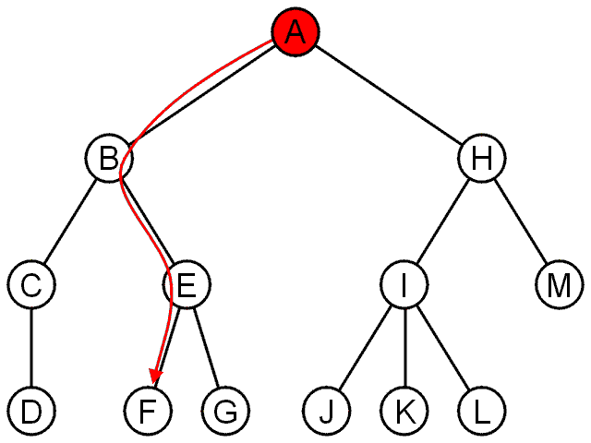
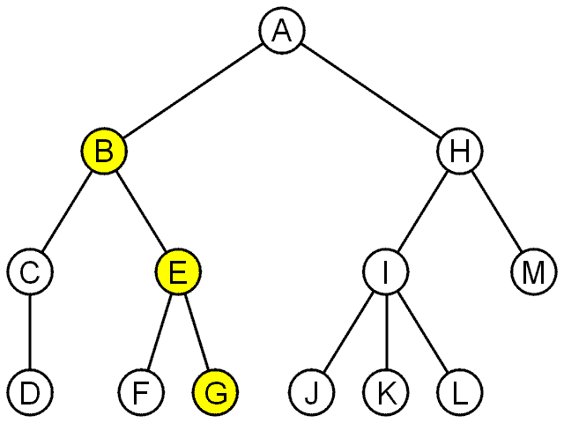
Tree Terminology
The shape of a rooted tree gives a natural flow from the root node, or just root
A path is a sequence of nodes
  (a₀, a₁, ..., a_{n}) where a_{k + 1} is a child of a_{k} is
  The length of this path is n
The path (B, E, G) has length 2

Slide 8
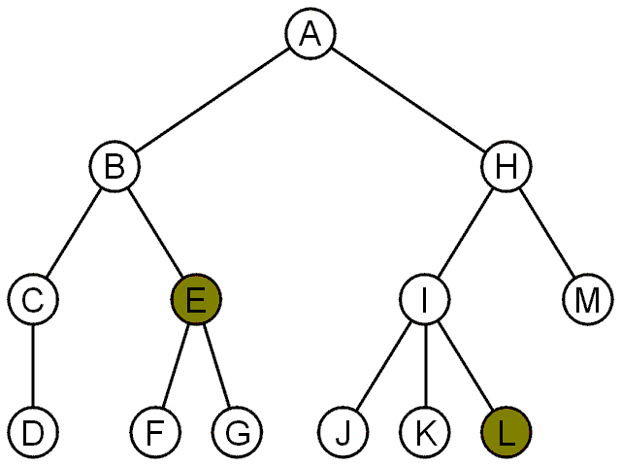
Tree Terminology
For each node in a tree, there exists a unique path from the root node to that node
The length of this path is the depth of the node, e.g.,
  E has depth 2
  L has depth 3
The height of a tree is defined as the maximum depth of any node within the tree
The height of a tree with one node is 0
  Just the root node
For convenience, we define the height of the empty tree to be –1

Slide 9
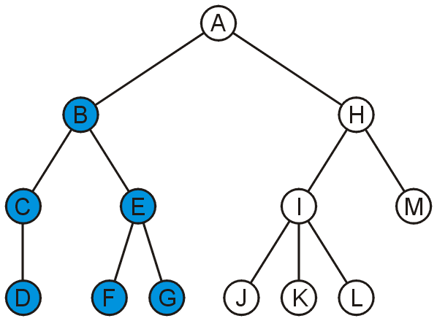
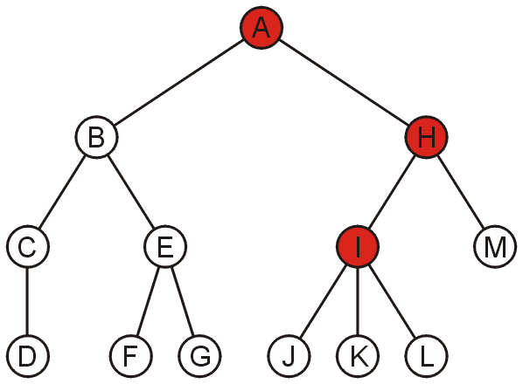
Tree Terminology
If a path exists from node a to node b:
  a is an ancestor of b
  b is a descendent of a
Thus, a node is both an ancestor and a descendant of itself
We can add the adjective strict to exclude equality:
      b is a strict descendent of a if b is a descendant of a but a ≠ b
The root node is an ancestor of all nodes
The descendants of node B are B, C, D, E, F, and G:
The ancestors of node I are I, H, and A:

Slide 10
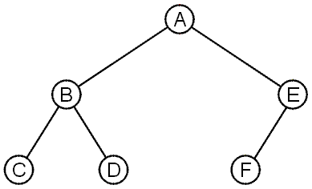
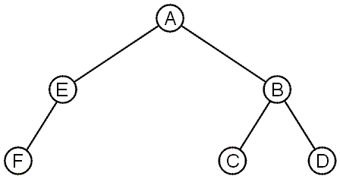
Tree Terminology
These trees are equal if the order of the children is ignored
  unordered trees
They are different if order is relevant (ordered trees)
  We will usually examine ordered trees (linear orders)
    linear ordering defined for the children of each node;
    that is, we can identify children of a node as being the first, second, third, and so on.
    determined by how the tree is to be used, and corresponding to their linear relationship

Slide 11
Binary Trees
A binary tree is an ordered tree in which every node has at most two children.
  Every node has at most two children.
  Each child node is labeled as being either a left child or a right child.
  A left child precedes a right child in the ordering of children of a node.
left subtree: subtree rooted at a left child of an internal node
right subtree : subtree rooted at a right child of an internal node
proper (or full) binary tree: if each node has either zero or two children.
  every internal node has exactly two children.
A binary tree that is not proper is improper.
Applications:
  arithmetic expressions
  decision processes
  searching
A
B
C
D
E
F
G
H
I

Slide 12
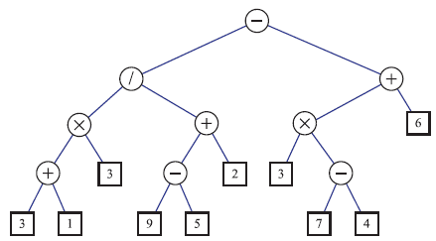
Arithmetic Expression Tree
Binary tree associated with an arithmetic expression
  internal nodes: one of the operators +, −, ×, and /
  external nodes: operands
If a node is external,
  then its value is that of its variable or constant.
If a node is internal,
  then its value is defined by applying its operation to the values of its children.
Example:
arithmetic expression tree for the expression ((((3+1)×3)/((9−5)+2))−((3×(7−4))+6)).

Slide 13

Decision Tree
Binary tree associated with a decision process
  internal nodes: questions with yes/no answer
  external nodes: decisions
Example:
tree providing investment advice

Slide 14
A Recursive Binary Tree Definition
A binary tree T can be defined in a recursive way such that a binary tree is either empty or consists of:
  A node r, called the root of T and storing an element
  A binary tree, called the left subtree of T
  A binary tree, called the right subtree of T

Slide 15
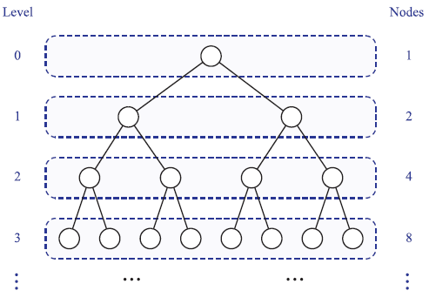
Properties of Binary Trees
Nodes of a tree T, at the same depth d, as the level d of T.
  level 0 has one node (the root),
  level 1 has, at most, two nodes (the children of the root),
  level 2 has, at most, four nodes, and so on.
  In general, level d has, at most, 2^{d} nodes.
maximum number of nodes on the levels grows exponentially as we go down the tree.
Maximum Number of nodes
N = 2⁰ +2¹ + 2² +2³ = 2⁴ –1=15
In General: N = 2^{L+1} –1 where L is the number of levels in a tree

Slide 16


Properties of Proper Binary Trees
Notation
  T be a nonempty binary tree
  n number of nodes
  n_{E} number of external nodes
  n_{I} number of internal nodes
  h height
T has the following properties
Also, if T is proper, then it has the following properties

Slide 17
Simple Tree Node Example
class Node {
  Node left; // left child
  Node right; // right child
  String firstName;
  String lastName;
  String employeeID;
}
Example1
Data in the node class
class EmployeeInformation{
String firstName;
String lastName;
String employeeID;
}
Example 2
Single data object referenced by node class
class Node {
Node left; // left child
Node right; // right child
EmployeeInformation employeeInfo;
}

Slide 18
Simple Binary Tree Code
// An IntTreeNode object is one node in a binary tree of ints.
public class IntTreeNode {
public int data; // data stored at this node
public IntTreeNode left; // reference to left subtree
public IntTreeNode right; // reference to right subtree
public IntTreeNode(int data) {// Constructs a leaf node with the given data.
this(data, null, null);
}
public IntTreeNode(int data, IntTreeNode left, IntTreeNode right) {
this.data = data; // Constructs a branch node with the given data and links.
this.left = left;
this.right = right;
}
}
left | elt | right
 | 42
IntTreeNode v = new IntTreeNode(42);
v.left = new IntTreeNode(59);
v.right = new IntTreeNode(27);
left | elt | right
 | 59
left | elt | right
 | 27

Slide 19
import java.util.*;
public class LinkedBinaryTree {
private IntTreeNode overallRoot; // null for an empty tree
private int n = 0;
public LinkedBinaryTree(){ //constructs an empty tree
overallRoot=null;
}
// constructs a tree with certain number of levels.
public LinkedBinaryTree(int level){
overallRoot=buildTree(3, 0, level);
}
public IntTreeNode buildTree(int m, int counter, int level){ // Builds a tree with certain number of levels.
if (level == 0) return null;
else if (counter < level){
IntTreeNode left = buildTree(2*m, counter+1, level); // left child has value of 2*m
IntTreeNode right = buildTree(2*m+1, counter+1, level); //right child has value of 2m + 1
n++;
return new IntTreeNode(m, left, right);
}
else
return null;
}
Simple Binary Tree Code represents a tree of ints.

Slide 20
  // Prints the tree in a sideways indented format.
  public void printSideways() {
  printSideways(overallRoot, "");
  }
  private void printSideways(IntTreeNode root, String indent) {
  if (root != null) {
  printSideways(root.right, indent + " ");
  System.out.println(indent + root.data);
  printSideways(root.left, indent + " ");
  }
  }
  public int size() { return n;}
  public boolean isEmpty() { return n==0;}
}
root
3
6
7
12
13
14
15
15
7
14
3
13
6
12
import java.util.*;
public class TreeTester {
public static void main(String[] args) {
LinkedBinaryTree tree = new LinkedBinaryTree(3);
tree.printSideways();
System.out.println();
System.out.println("Size : " + tree.size());
}
}

Slide 21
31
15
30
7
29
14
28
3
27
13
26
6
25
12
24
LinkedBinaryTree tree = new LinkedBinaryTree(4);
tree.printSideways();

Slide 22
BinaryTree: Node ADT
Each node p of the tree stores an element and supports the following operations:
p.getLeft(): | Return the left child of node p; an error condition occurs if p is an external node.
p.getRight(): | Return the right child of p; an error condition occurs if p is an external node.
p.getParent(): | Return the parent of p; an error occurs if p is the root.
p.isRoot(): | Return true if p is the root and false otherwise.
p.isExternal(): | Return true if p is external and false otherwise.
p.isInternal(): | Returns true if node p has at least one child
p.numChildren(): | Returns the number of children of node p.
p.sibling(): | Returns the sibling of node p (or null if p has no sibling)
p.children(): | Returns a collection containing the children of node p
p.set(e): | Replaces the element stored at node p with element e, and returns the previously stored element

Slide 23
LinkedBinaryTree ADT
The tree itself provides the same operations
size(): | Return the number of nodes in the tree..
isEmpty(): | Return true if the tree is empty and false otherwise.
root(): | Return the tree’s root; an error occurs if the tree is empty.
nodes(): | Return a list of all the nodes of the tree.
addRoot(e): | Creates a root for an empty tree, storing e as the element, and returns it; an error occurs if the tree is not empty.
addLeft(p, e): | Creates a left child of node p, storing element e, and returns the new node; an error occurs if p already has a left child
addRight(p, e): | Creates a right child of node p, storing element e, and returns the new node; an error occurs if p already has a right child
attach(p, T1, T2): | Attaches the internal structure of trees T1 and T2 as the respective left and right subtrees of leaf node p and resets T1 and T2 to empty trees; an error condition occurs if p is not a leaf.
remove(p): | Removes the node p, replacing it with its child (if any), and returns the element that had been stored at p; an error occurs if p has two children.
expandExternal(p, e1,e2): | Transform p from an external node into an internal node by creating two new external nodes and making them the left and right children of p, respectively

Slide 24
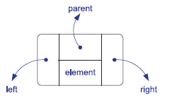
A Node class in a linked data structure for representing a binary tree.
public class Node {
private int element; // data stored at this node)for simplicity we set the type to int
private Node left; // reference to left subtree
private Node right; // reference to right subtree
private Node parent; // a reference to the parent node (if any)
// Constructors
public Node(int data) { this(data, null, null, null); }
public Node(int data, Node above, Node leftChild, Node rightChild) {
element = data;
parent = above;
left = leftChild;
right = rightChild;
}
// accessor methods
public int getElement() { return element; }
public Node getParent() { return parent; }
public Node getLeft() { return left; }
public Node getRight() { return right; }
// mutator methods
public void setElement(int e) { element = e; }
public void setParent(Node parentNode) { parent = parentNode; }
public void setLeft(Node leftChild) { left = leftChild; }
public void setRight(Node rightChild) { right = rightChild; }

Slide 25
A Node class in a linked data structure for representing a binary tree.
// other methods
public boolean isInternal() { return numChildren() > 0; }
public boolean isExternal() { return numChildren() == 0; }
public boolean isRoot() { return parent ==null; }
public int numChildren() {
int count=0;
if (left != null)
count++;
if (right != null)
count++;
return count;
}
public List<Node> children() {
List<Node> snapshot = new ArrayList<>(2); // max capacity of 2
if (left != null)
snapshot.add(left);
if (right != null)
snapshot.add(right);
return snapshot;
}
}

Slide 26
A Node class in a linked data structure for representing a binary tree.
// other methods
public Node sibling() {
if (parent == null) return null; // p must be the root
if (this == parent.left) // p is a left child
return parent.right; // (right child might be null)
else // p is a right child
return parent.left; // (left child might be null)
}
public int set(int e) {
int temp = element;
element = e;
return temp;
}
}

Slide 27
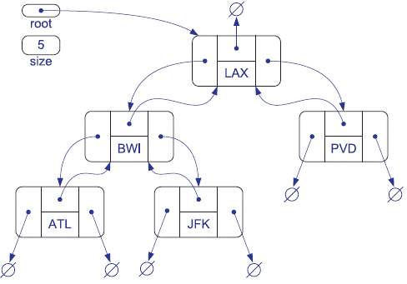
A Linked Structure for Binary Trees

Slide 28
class LinkedBinaryTree {
private Node root = null; // root of the tree
private int size = 0; // number of nodes in the tree
public LinkedBinaryTree() { } // constructs an empty binary tree
//Returns the number of nodes in the tree.
public int size() { return size; }
public boolean isEmpty() { return size == 0; }
public Node root() { return root; } // Returns the root of the tree (or null if tree is empty).
// Places element e at the root of an empty tree and returns its new Position.
public Node addRoot(int e) throws IllegalStateException {
if (!isEmpty()) throw new IllegalStateException("Tree is not empty");
root = new Node(e);
size = 1;
return root;
}
//more methods to be added
}

Slide 29
expandExternal(p): Transform p from an external node into an internal node by creating two new external nodes and making them the left and right children of p, respectively.
void expandExternal(Node v, int lval, int rval) {
Node left = new Node(lval); // create left node
v.setLeft(left); // add a new left child
left.setParent(v); // v is its parent
Node right = new Node(rval); // create right node
v.setRight(right); // add a new right child
right.setParent(v); // v is its parent
size = size + 2; // two more nodes
}
∅
D
∅
∅
∅
∅
C
E

Slide 30
A Linked Structure for Binary Trees
public List<Node> nodes() { return preorder(); }
public List<Node> preorder() {
List<Node> snapshot = new ArrayList<>();
if (!isEmpty())
preorderSubtree(root(), snapshot); // fill the snapshot recursively
return snapshot;
}
private void preorderSubtree(Node p, List<Node> snapshot) {
snapshot.add(p); // for preorder, we add position p before exploring subtrees
for (Node c : p.children())
preorderSubtree(c, snapshot);
}

Slide 31
Traversals
traversal: An examination of the elements of a tree.
  A pattern used in many tree algorithms and methods
Common orderings for traversals:
  pre-order: process root node, then its left/right subtrees
  in-order: process left subtree, then root node, then right
  post-order: process left/right subtrees, then root node
  Example
pre-order: 17 41 29 6 9 81 40
in-order: 29 41 6 17 81 9 40
post-order: 29 6 41 81 40 9 17
overallRoot
17
41
9
29
6
81
40

Slide 32
Preorder Traversal- Binary Tree
Algorithm binaryPreorder(p):
perform the “visit” action for node p
If p is an internal node then
binaryPreorder( p.left) {recursively traverse left subtree}
binaryPreorder(p.right) {recursively traverse right subtree}
public List<Node> preorder() {
List<Node> snapshot = new ArrayList<>();
if (!isEmpty())
// fill the snapshot recursively
preorderSubtree(root(), snapshot);
return snapshot;
}
private void preorderSubtree(Node p, List<Node> snapshot) {
snapshot.add(p); // we add p before exploring subtrees
for (Node c : p.children())
preorderSubtree(c, snapshot);
}
LAX, BWI, ATL, JFK, PVD.

Slide 33
Preorder Traversal- General Tree
A traversal visits the nodes of a tree in a systematic manner
In a preorder traversal, a node is visited before its descendants
Application: print a structured document
Algorithm preOrder(v)
  visit(v)
  for each child w of v
  preorder (w)
33

Slide 34
Postorder Traversal-Binary Tree
Algorithm binaryPostorder(p):
If p is an internal node then
binaryPostorder(p.left()) {recursively traverse left subtree}
binaryPostorder( p.right()) {recursively traverse right subtree}
perform the “visit” action for node p
public List<Node> postorder() {
List<Node> snapshot = new ArrayList<>();
if (!isEmpty())
// fill the snapshot recursively
postorderSubtree(root(), snapshot);
return snapshot;
}
private void postorderSubtree(Node p, List<Node> snapshot){
for (Node c : p.children())
postorderSubtree(c, snapshot);
snapshot.add(p); // add node p after exploring subtrees
}
ATL, JFK, BWI, PVD, LAX

Slide 35
Postorder Traversal
Algorithm evalExpr(v)
  if isExternal (v)
    return v.element ()
  else
  x ← evalExpr(left(v))
  y ← evalExpr(right(v))
  ◊ ← operator stored at v
    return x ◊ y
Specialization of a postorder traversal
  recursive method returning the value of a subtree
  when visiting an internal node, combine the values of the subtrees
+
×
×
2
−
3
b
a
1

Slide 36
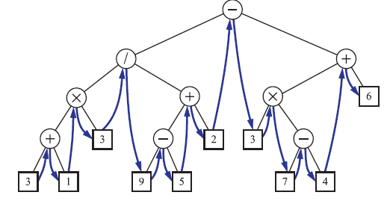
Inorder Traversal- Binary Tree
In an inorder traversal a node is visited after its left subtree and before its right subtree
The two algorithms are the same but written differently
Algorithm inOrder(v)
  if left (v) ≠ null
    inOrder (left (v))
  visit(v)
  if right(v) ≠ null
    inOrder (right (v))
Algorithm inorder(v):
if v is an internal node then
inorder(v.left()) {recursively traverse left subtree}
perform the “visit” action for node v
if v is an internal node then
inorder(v.right()) {recursively traverse right subtree}
ATL,BWI, JFK,LAX,PVD.

Slide 37
Inorder Traversal- Binary Tree
Algorithm inOrder(v)
  if left (v) ≠ null
    inOrder (left (v))
  visit(v)
  if right(v) ≠ null
    inOrder (right (v))
Algorithm inorder(v):
if v is an internal node then
inorder(v.left()) {recursively traverse left subtree}
perform the “visit” action for node v
if v is an internal node then
inorder(v.right()) {recursively traverse right subtree}
public List<Node> inorder() {
List<Node> snapshot = new ArrayList<>();
if (!isEmpty())
inorderSubtree(root(), snapshot); // fill the snapshot recursively
return snapshot;
}
private void inorderSubtree(Node p, List<Node> snapshot) {
if (p.getLeft() != null)
inorderSubtree(p.getLeft(), snapshot);
snapshot.add(p);
if (p.getRight() != null)
inorderSubtree(p.getRight(), snapshot);
}

Slide 38
Numbers reflect the order in which the nodes are processed
4
1
5
2
5
2
5
3
4
1
3
3
4
1
2
inorder
preorder
postorder
*
Inorder: (A+B)*(C/D)
+
/
Postorder:AB+CD/*
A
B
C
D
Preorder:*+AB/CD

Slide 39
Inorder recursive Traversal
inOrder (Node node) {
if (node != NULL) {
inOrder (node.left);
System.out.print(node.getElement()+ “ “);
inOrder (node.right);
}
}
27
13
51
inOrder(27)
12
26
1
33
inOrder(13)
Print 27
inOrder(51)
12
13
inOrder(51)
2
inOrder(33)
inOrder(33)
Print 51
inOrder(null)
14
inOrder(null)
Print 33
inOrder(null)
15
inOrder(13)
18
inOrder(12)
Print 13
inOrder(26)
19
16
17
3
7
8
inOrder(12)
inOrder(26)
inOrder(null)
Print 12
inOrder(null)
inOrder(null)
Print 26
inOrder(null)
12
13
26
27
33
51
4
9
5
10
6
11

Slide 40
Print Arithmetic Expressions
Algorithm printExpression(v)
  if v.isInternal()
  print(“(’’)
    inOrder(v.left())
  print(v.element())
  if v.isInternal()
    inOrder(v.right())
  print (“)’’)
Specialization of an inorder traversal
  print operand or operator when visiting node
  print “(“ before traversing left subtree
  print “)“ after traversing right subtree
+
×
×
2
−
3
b
((2 × (a − 1)) + (3 × b))
a
1

Slide 41
Breadth-First Tree Traversal
Visit all the nodes at depth d before we visit the nodes at depth d+1
Used in software for playing games.
  tree represents the possible choices of moves, with the root of the tree being the initial configuration for the game.
Algorithm is not recursive, since we are not traversing entire subtrees at once. We use a queue to produce a FIFO semantics for the order in which we visit nodes.
Algorithm breadthfirst( ):
Initialize queue Q to contain root( )
while Q not empty do
p = Q.dequeue( ) { p is the oldest entry in the queue }
perform the “visit” action for position p
for each child c in children(p) do
Q.enqueue(c) { add p’s children to the end of the queue for later visits }
The overall running time is O(n), due to the n calls to enqueue and n calls to dequeue.

Slide 42
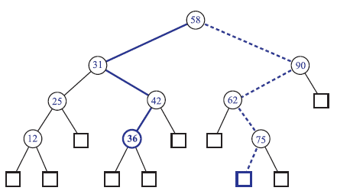
Binary Search Tree (BST)
Let S be a set whose elements have an order relation. For example, S could be a set of integers.
A binary search tree for S is a proper binary tree T such that:
  Each internal node p of T stores an element of S, denoted with x(p)
  For each internal node p of T, the elements stored in the left subtree of p are less than or equal to x(p) and the elements stored in the right subtree of p are greater than or equal to x(p)
  The external nodes of T do not store any element
The solid path is traversed when searching (successfully) for 36.
The dashed path is traversed when searching (unsuccessfully) for 70.

Slide 43
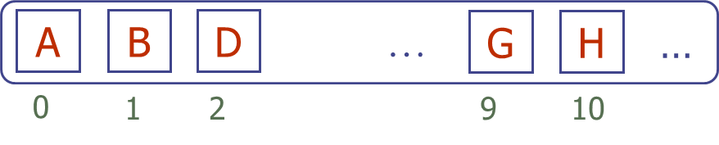
A Array-Based Structure for Binary Trees
Nodes stored in a array: simple structure for representing a binary tree T is based on a way of numbering the nodes of T.
For every node v of T, let f (v) be the integer (index) defined as follows:
  Node v is stored at A[f(v)]
  If v is the root of T, then f (v) = 0
  If v is the left child of node u, then f (v) = 2 f (u)+1
  If v is the right child of node u, then f (v) = 2 f (u)+2
Such an implementation is simple and efficient.
  we can easily perform the functions root, parent, left, right, sibling, isExternal, and isRoot by using simple arithmetic operations on the numbers f (v).
The array implementation of a binary tree is a fast and easy way of realizing the binary-tree ADT, but it can be space inefficient if the height of the tree is large.
0
A
1
2
B
D
3
4
5
6
E
F
C
J
9
10
G
H

